Slide 1


COMP3411 13A WK4
KELVIN YANG

Slide 2
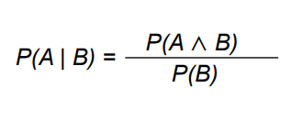
Part 1: Uncertainty
Conditional probability
Bayes’ Rule

Slide 3
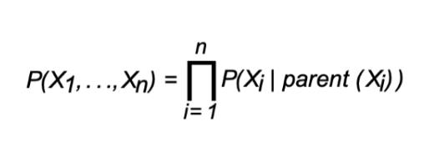
Part 1: Belief Network
Parents of a rv Xi is the minimal set of predecessors of Xi such that other predecessors are conditionally independent of Xi given parents (Xi)
iPad Demo

Slide 4

Part 2: Reinforcement Learning
Q-Learning
Deduce from a fixed policy value function
iPad Demo

Slide 5
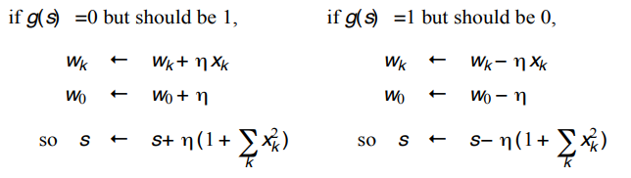
Part 3: Neural Networks
Geometrical Induction
Perceptron Learning Algorithm
iPad Demo

Slide 6


Questions/Feedback/Reminder
Any questions?
Any feedback?
Assignment question: please send to cs3411@cse.unsw.edu.au or post them on Openlearning assignment page
Anna and Joshua will answer you questions for sure!
Don’t forget to do your homework! You know the deal now.

